Slide 1
Master Artifact
VDS AI Tooling
Andrew Pendleton
CX Design Systems
Core Product
Project

Slide 2
Verizon Design Systems
Executive Summary | AI Tooling
Strategic Themes
North Star
Leads
01
Introducing VDS AI Tooling: A suite of intelligent assistants! A Figma plugin (VDS Design Assistant) and VS Code extension (VDS Dev Assistant) will provide instant, in-context access to VDS components, guidelines, and an AI chatbot. Plus, a powerful Similarity Engine will automate visual audits and unlock new design capabilities.
Revolutionizing how teams build by embedding AI-powered VDS intelligence directly into design and development workflows. Transforming VDS into an intuitive, proactive AI partner in Figma & VS Code, ensuring effortless adoption, perfect consistency, and supercharged productivity for every user, on every project.
Andrew Pendleton
Workstream Lead
Andrew Pendleton
Initiative Lead
Mobile
Fios
FWA
Scale
02
Customer Impact
Designers & developers get a VDS AI co-pilot! They'll access VDS assets & answers instantly within Figma/VS Code, slashing friction & search time. Expect unprecedented efficiency, faster onboarding, higher quality outputs, and greater confidence in applying VDS correctly. This means more time creating, less time wrestling with tools or seeking help.
KPIs Impacted
P*Q
$-
Incr. Revenue
$-
Call Volume Opt.
Other Cost Savings
03
Business Impact
$-
Handle Time Opt.
$-
Other Benefit Value
VDS AI Tooling will ignite development speed, dramatically cut VDS support costs, and elevate product quality & consistency across all Verizon experiences. By automating tedious tasks like visual audits and providing intelligent support, we unlock significant efficiency gains, accelerate innovation, and amplify the ROI of our entire VDS ecosystem.
$TBDM
Total 2026 Capex + Opex
Incremental Request

Slide 3
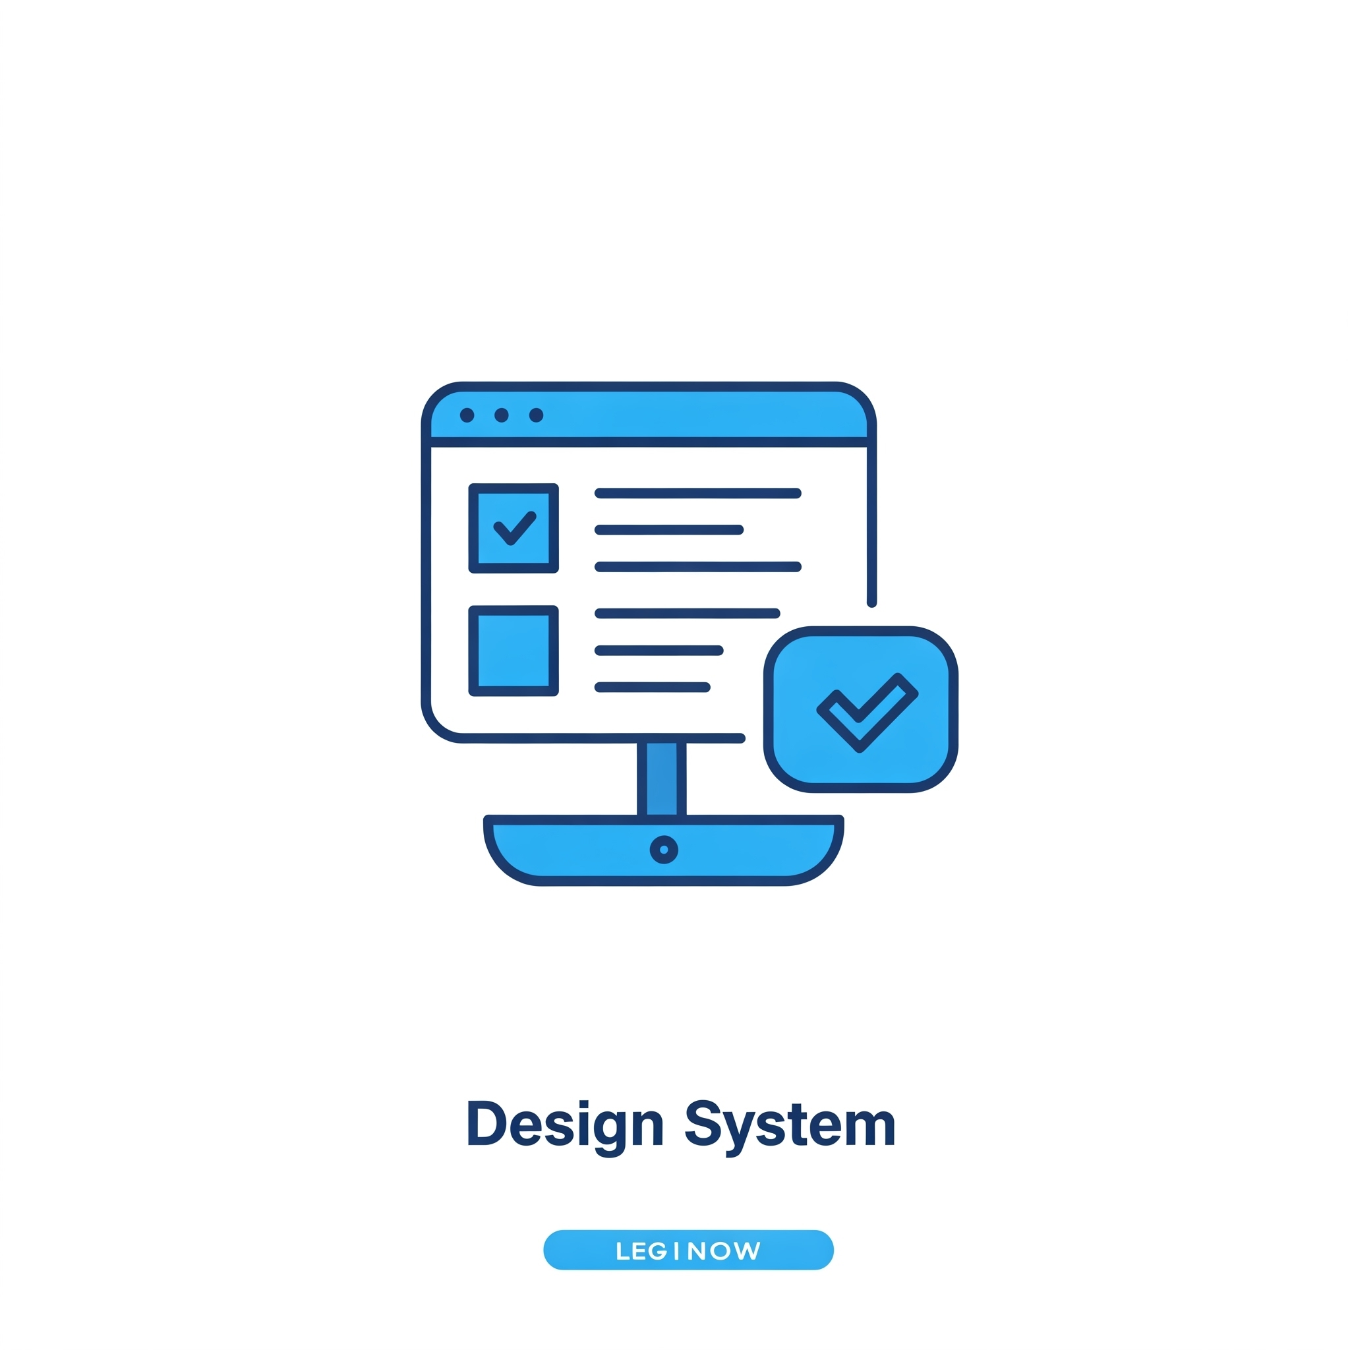



Verizon Design Systems
Journey Map | AI Tooling
VDS Design Assistant
Sitting right inside Figma, the VDS Design Assistant watches what you’re drawing and quietly points you to the exact component, token, or spacing rule that fits, then flags anything that drifts.
It cuts the back-and-forth review cycle to minutes, so designers spend more time exploring ideas and less time hunting for “the right way.”
Over time it learns from real projects, so its nudges get sharper without adding noise.
Impact: Smoother hand-offs and consistently on-brand interfaces, without extra meetings or retraining.
VDS Development Assistant
Running in VS Code, our devs’ natural habitat, the VDS Developer Assistant autocompletes imports, shows prop examples, and warns when code veers off spec or a newer component version is available.
It trims setup and PR cleanup, letting engineers focus on features while knowing their build will pass design-system checks the first time.
Built-in support for test frameworks and CI hooks drops seamlessly into existing pipelines with almost no extra setup.
Impact: cleaner merges, fewer late-stage bugs, and faster releases that look and behave exactly as intended.
Similarity Engine
An AI tool that scans the CX Design Figma workspace to quickly find duplicate, inconsistent, or off-brand components.
This will enable the VDS team to spot patterns, clean up design drift, and keep experience design work aligned with minimal manual audits. This engine will also be able to power other AI tools for adopters by providing accurate, real-time design pattern data—fueling assistants that suggest the right components, flag inconsistencies, or automate VQA during design and development.
Impact: higher quality and consistency across the entire Verizon ecosystem at scale.

Slide 4

VDS AI Tooling
VDS Product: Operational Efficiency
Workstream Lead: Andrew Pendleton
Initiative Lead: Andrew Pendleton
Northstar
Scope
Results
The Idea
Problem & Opportunity
Today, using VDS involves manual searches, context switching for support in Slack, and tedious VDS team effort answering repetitive questions. This friction slows down our designers and developers, breeds inconsistency, and drains resources. Valuable time is lost on manual visual audits and VQA, delaying innovation and time-to-market.
Proposed Solution
Introducing VDS AI Tooling: A suite of intelligent assistants! A Figma plugin (VDS Design Assistant) and VS Code extension (VDS Dev Assistant) will provide instant, in-context access to VDS components, guidelines, and an AI chatbot. Plus, a powerful Similarity Engine will automate visual audits and unlock new design capabilities.
Customer Impact
Designers & developers get a VDS AI co-pilot! They'll access VDS assets & answers instantly within Figma/VS Code, slashing friction & search time. Expect unprecedented efficiency, faster onboarding, higher quality outputs, and greater confidence in applying VDS correctly. This means more time creating, less time wrestling with tools or seeking help.
Business Impact
VDS AI Tooling will ignite development speed, dramatically cut VDS support costs, and elevate product quality & consistency across all Verizon experiences. By automating tedious tasks like visual audits and providing intelligent support, we unlock significant efficiency gains, accelerate innovation, and amplify the ROI of our entire VDS ecosystem.
Revolutionizing how teams build by embedding AI-powered VDS intelligence directly into design and development workflows. Transforming VDS into an intuitive, proactive AI partner in Figma & VS Code, ensuring effortless adoption, perfect consistency, and supercharged productivity for every user, on every project.

Slide 5
Expected Results
Northstar
Scope
Results
CX Workstream Name
KPI’s Impacted- Section 1
CX Excellence
⬜ | Customer Satisfaction (CSAT) |  |  |  | ⬜ | Rep Interaction Score (RIS) |  |  |  | ⬜ | Churn Reduction
⬜ | 3-day Resolve |  |  |  | ⬜ | Digital Interaction Score (DIS)
Revenue Growth
⬜ | Service Product Revenue |  |  |  |  | ⬜ | Overall Conversion
⬜ | Service Product Revenue |  |  |  |  | ⬜ | Prospect Conversion
Operational Efficiency
⬜ | Call Volume Optimization (CVO) |  |  |  |  |  | ⬜ | Average Handle Time (AHT)
⬜ | Retail Transaction Time |  |  |  |  |  | ❎ | Other Cost Savings
Financial Scope & Targets (P*Q)- Section 2
Benefit Value Estimates
Incremental Revenue $_______ Call Volume Optimization $________ Handle Time Optimization $_______ Other Benefit Value $________ (please explain)
Investment Planning - Section 3 (CXO IPG to complete this section)
Capital Investment Estimates
GTS Labor estimate $__________ Non-GTS estimate $__________
Operating Expense for Initiative (Incremental) CXO Operating Cost (OPEX) $________ CXO Incremental Headcount ________

Slide 6
2026 Capex + Opex Incremental
Northstar
Scope
Results
Xxx (i.e. Koenders, Butler etc.) | xxx (i.e. CX, Experience Product, Digital Channel etc.)
Status | Opex ID | Product Area | EMR (see notes) | Initiative Name | Vendor Name | Description | Budget
C | Opex-xxx | Assisted Experience | Contracted Services | <Name> | <Vendor> | <Description> | $XXX.XX
N | New
C | Continue
S | Stop
Notes:
Expense Management Record (EMR) Categories
Advertising and Promotion
Contracted Services
Direct Costs
Full Time Labor
HR and Training
IT and Technology Contracts
Other Operating Costs
Overhead Costs
Professional Services Fees
Sales Incentives
Temporary Labor
Travel and Internal Events

Slide 7
2026 Opex Only
Northstar
Scope
Results
Xxx (i.e. Koenders, Butler etc.) | xxx (i.e. CX, Experience Product, Digital Channel etc.)
Status | Opex ID | Product Area | EMR (see notes) | Initiative Name | Vendor Name | Description | Budget
C | Opex-xxx | Assisted Experience | Contracted Services | <Name> | <Vendor> | <Description> | $XXX.XX
N | New
C | Continue
S | Stop
Notes:
Expense Management Record (EMR) Categories
Advertising and Promotion
Contracted Services
Direct Costs
Full Time Labor
HR and Training
IT and Technology Contracts
Other Operating Costs
Overhead Costs
Professional Services Fees
Sales Incentives
Temporary Labor
Travel and Internal Events

Slide 9
Master Artifact
Initiative Name
Submitter Name
Band 5 Team Name
Core Product
Project

Slide 10
2026 CXO Planning
For CX Strategy Use - Do Not Fill Out
Workstream Name | Initiative Name TEMPLATE
Northstar:
Strategic Themes
Journey Map
01
Program goal
Key activity
Key activity
Key activity
Key activity
High-level program goal description/objective
02
Program goal
Key activity
Key activity
Key activity
Key activity
High-level program goal description/objective
03
Program goal
High-level program goal description/objective
Expected Outcomes
Expected Results
04
Program goal
Name of KPI
Name of KPI
$XX
Incr. Revenue
$XX
Call Volume Opt.
High-level program goal description/objective
05
Program goal
Name of KPI
Name of KPI
$XX
Handle Time Opt.
$XX
Other Benefit Value
High-level program goal description/objective
Name of KPI
Name of KPI
$XXM
Total 2026 Capex + Opex
Incremental Request

Slide 11
Initiative Name
Workstream Name
Workstream Lead: Name
Initiative Lead: Name
Template
Northstar
Scope
Results
Strategic Themes
[EXAMPLE] Customer need or problem being solved
Giving customers visibility and creating end to end ownership on issues that we cannot resolve on the initial interaction
Customer need or problem is being solved
[What will be unlocked for the customer or business?]
Customer need or problem being solved
[What will be unlocked for the customer or business?]
Customer need or problem being solved
[What will be unlocked for the customer or business?]
Customer need or problem being solved
[What will be unlocked for the customer or business?]
[Northstar statement - Ambition Here]

Slide 12
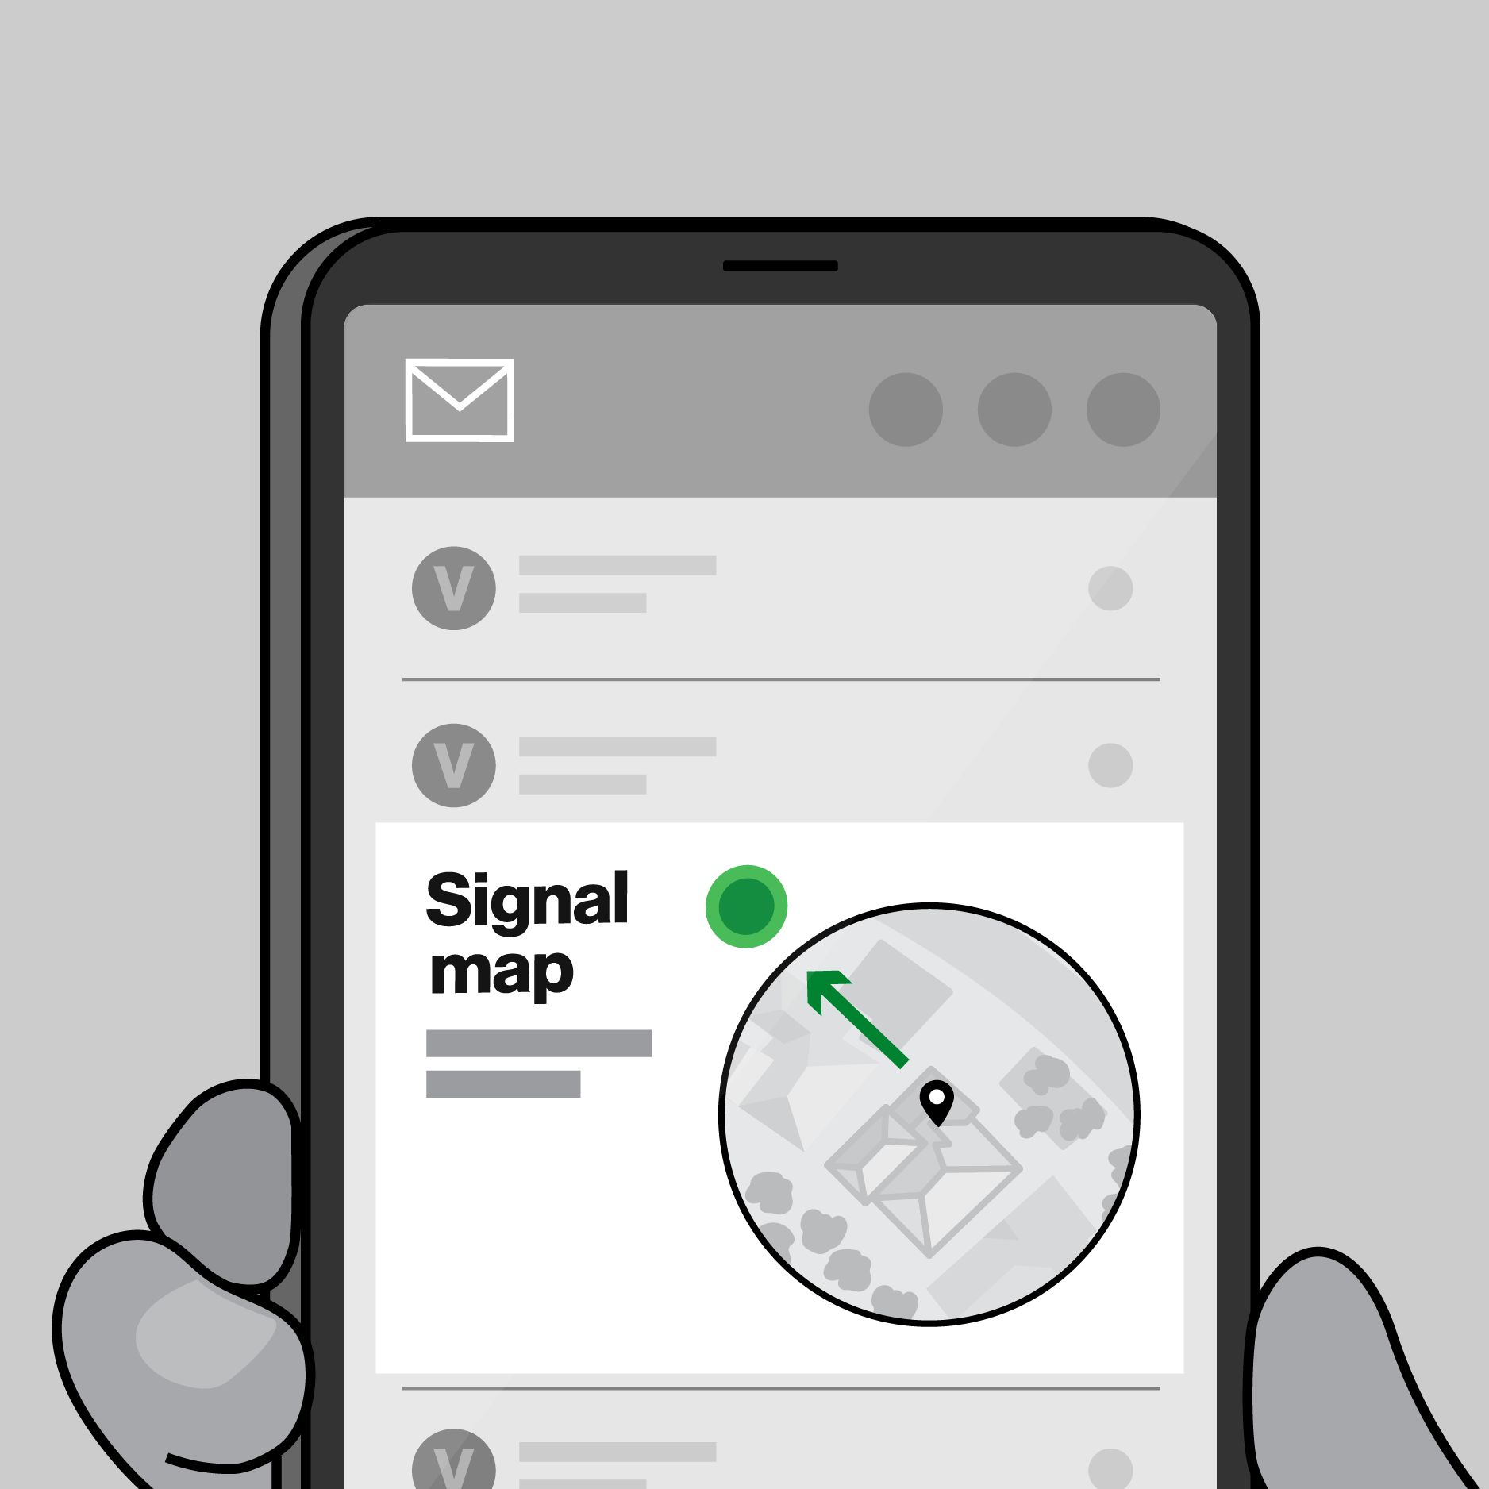
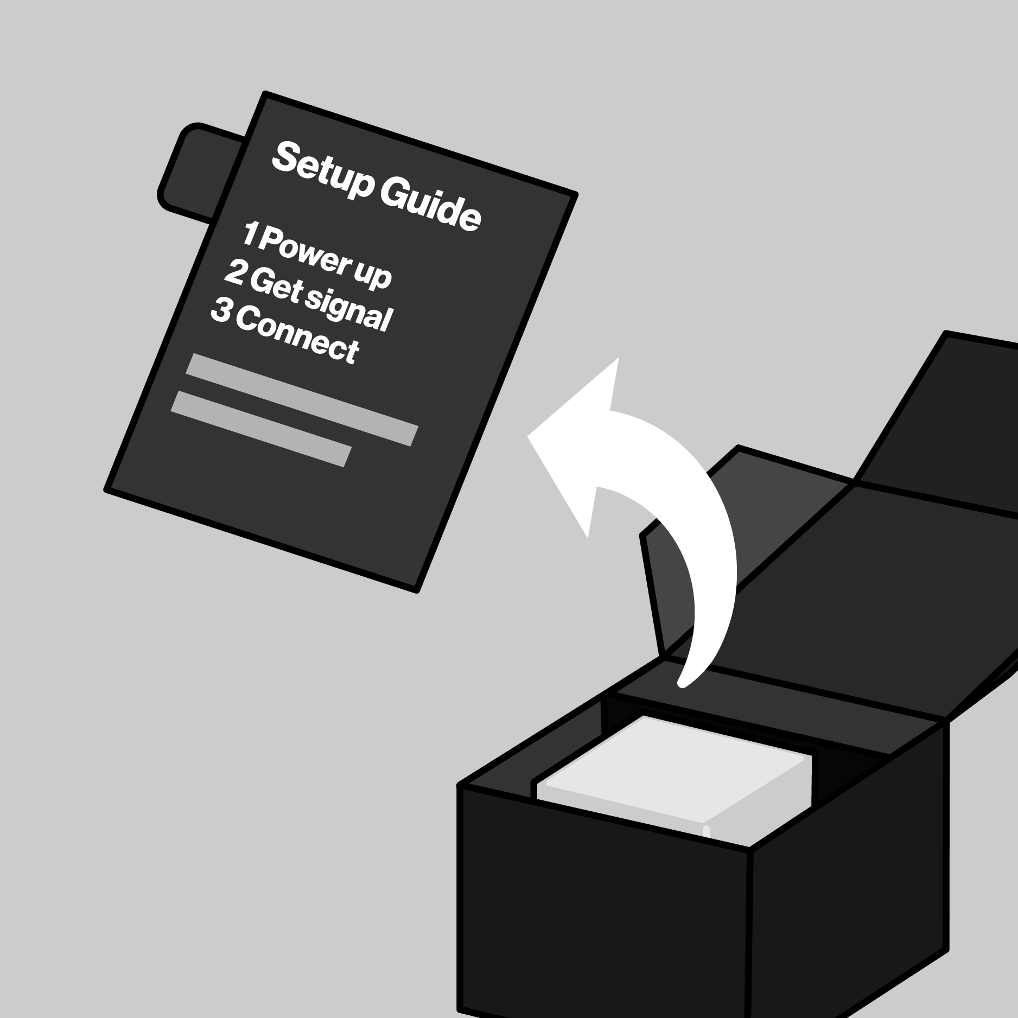


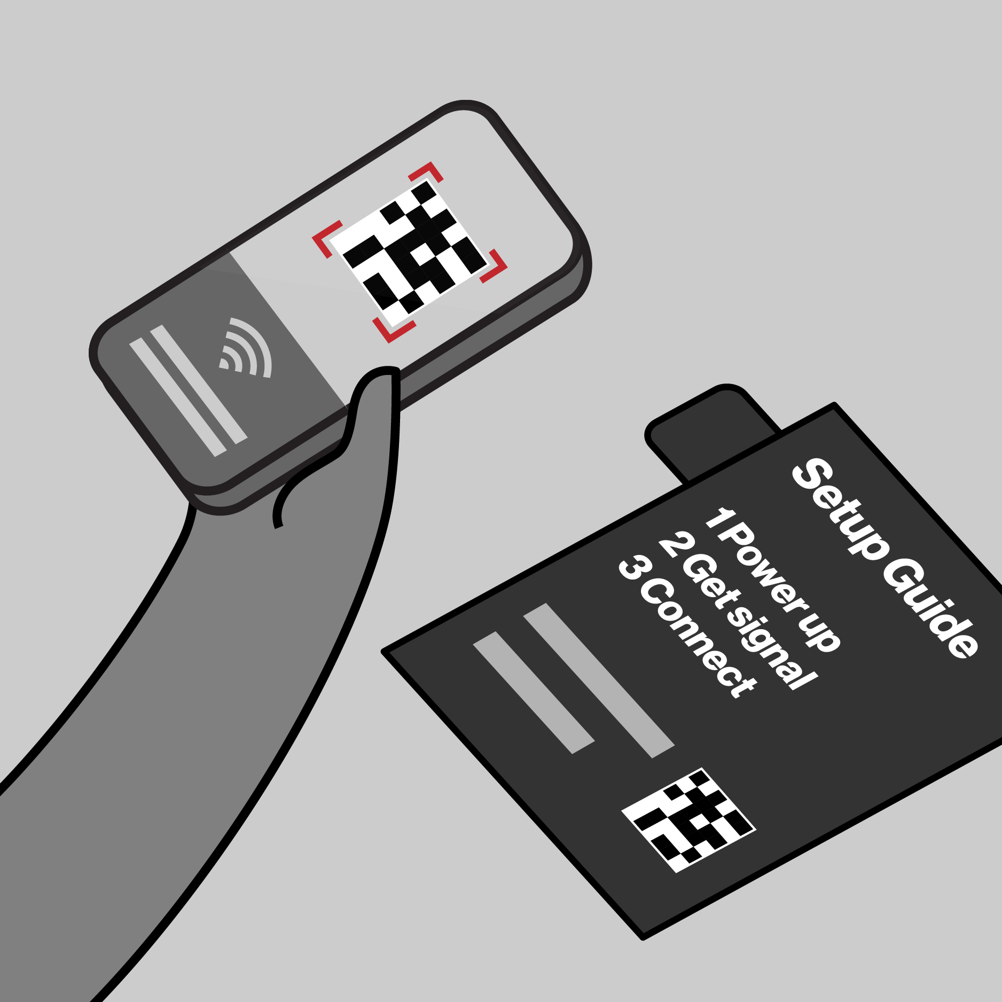
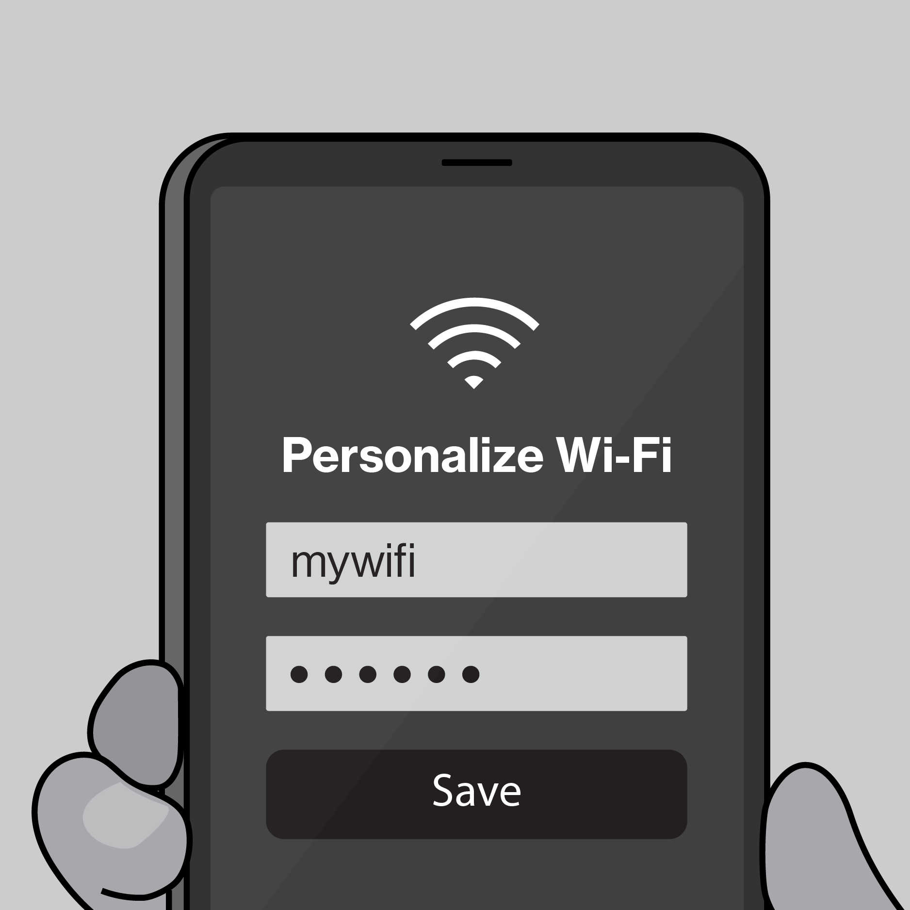

Template
Northstar
Scope
Results
CX Workstream Name
Journey Map Template
Illustrative Only
Key Customer Actions
Description customer objectives and actions
Key Customer Actions
Description customer objectives and interactions
Key Customer Actions
Description customer objectives and interactions
Key Customer Actions Description customer objectives and interactions
Key Customer Actions
Description customer objectives and interactions
Key Customer Actions
Description customer objectives and interactions
Key interactions
Key Interactions w/ Verizon
Key Interactions w/ Verizon
Key Interactions w/ Verizon
Key Interactions w/ Verizon
Key Interactions w/ Verizon
Key Interactions w/ Verizon

Slide 13
Expected Results
Template
Northstar
Scope
Results
CX Workstream Name
KPI’s Impacted- Section 1
CX Excellence
⬜ | Customer Satisfaction (CSAT) |  |  |  | ⬜ | Rep Interaction Score (RIS) |  |  |  | ⬜ | Churn Reduction
⬜ | 3-day Resolve |  |  |  | ⬜ | Digital Interaction Score (DIS)
Revenue Growth
⬜ | Service Product Revenue |  |  |  |  | ⬜ | Overall Conversion
⬜ | Service Product Revenue |  |  |  |  | ⬜ | Prospect Conversion
Operational Efficiency
❎ | Call Volume Optimization (CVO) |  |  |  |  |  | ⬜ | Average Handle Time (AHT)
⬜ | Retail Transaction Time |  |  |  |  |  | ⬜ | Other Cost Savings
Financial Scope & Targets (P*Q)- Section 2
Benefit Value Estimates
Incremental Revenue $_______ Call Volume Optimization $________ Handle Time Optimization $_______ Other Benefit Value $________ (please explain)
Investment Planning - Section 3 (CXO IPG to complete this section)
Capital Investment Estimates
GTS Labor estimate $__________ Non-GTS estimate $__________
Operating Expense for Initiative (Incremental) CXO Operating Cost (OPEX) $________ CXO Incremental Headcount ________
Notes:
Add in a grey box over area that business should not complete for clarity, re-org details

Slide 14
2026 Capex + Opex Incremental
Northstar
Scope
Results
Xxx (i.e. Koenders, Butler etc.) | xxx (i.e. CX, Experience Product, Digital Channel etc.)
Status | Opex ID | Product Area | EMR (see notes) | Initiative Name | Vendor Name | Description | Budget
C | Opex-xxx | Assisted Experience | Contracted Services | <Name> | <Vendor> | <Description> | $XXX.XX
N | New
C | Continue
S | Stop
Notes:
Expense Management Record (EMR) Categories
Advertising and Promotion
Contracted Services
Direct Costs
Full Time Labor
HR and Training
IT and Technology Contracts
Other Operating Costs
Overhead Costs
Professional Services Fees
Sales Incentives
Temporary Labor
Travel and Internal Events

Slide 15
2026 Opex Only
Northstar
Scope
Results
Xxx (i.e. Koenders, Butler etc.) | xxx (i.e. CX, Experience Product, Digital Channel etc.)
Status | Opex ID | Product Area | EMR (see notes) | Initiative Name | Vendor Name | Description | Budget
C | Opex-xxx | Assisted Experience | Contracted Services | <Name> | <Vendor> | <Description> | $XXX.XX
N | New
C | Continue
S | Stop
Notes:
Expense Management Record (EMR) Categories
Advertising and Promotion
Contracted Services
Direct Costs
Full Time Labor
HR and Training
IT and Technology Contracts
Other Operating Costs
Overhead Costs
Professional Services Fees
Sales Incentives
Temporary Labor
Travel and Internal Events

Slide 16
Example
2026 Planning Artifacts
Journey Map Example
Post-Sale / Pre-Setup
Taylor gets a confirmation email to set her up for success.
1. Unbox
On opening the box, Taylor sees a simple 1-2-3 set of instructions for setup
2. Find a spot
Using what she learned in-store, she chooses a spot to plug-in.
3. Activate internet
When the light turns solid white she’s setup. If help is needed, she refers to the 5G Compass in MVA.
Download / Open MVA
If Taylor wants to personalize her network, she can scan the QR code or enter the URL to deep link in My Verizon app.
Personalize internet
Once she has the My Verizon app open, there are a variety of personalizations and settings that she can change.
Key interactions
Confirmation email / Get ready page
Register
Download MVA
5G signal map + compass
Setup guide
Device
Power adapter
LED status
Wi-Fi name/password
5G signal map + compass
Setup guide
My Verizon app
Authentication
My Verizon app
Set Wi-Fi name/password
Connect devices

Slide 17
Master Artifacts
Due 5/19

